Slide 1
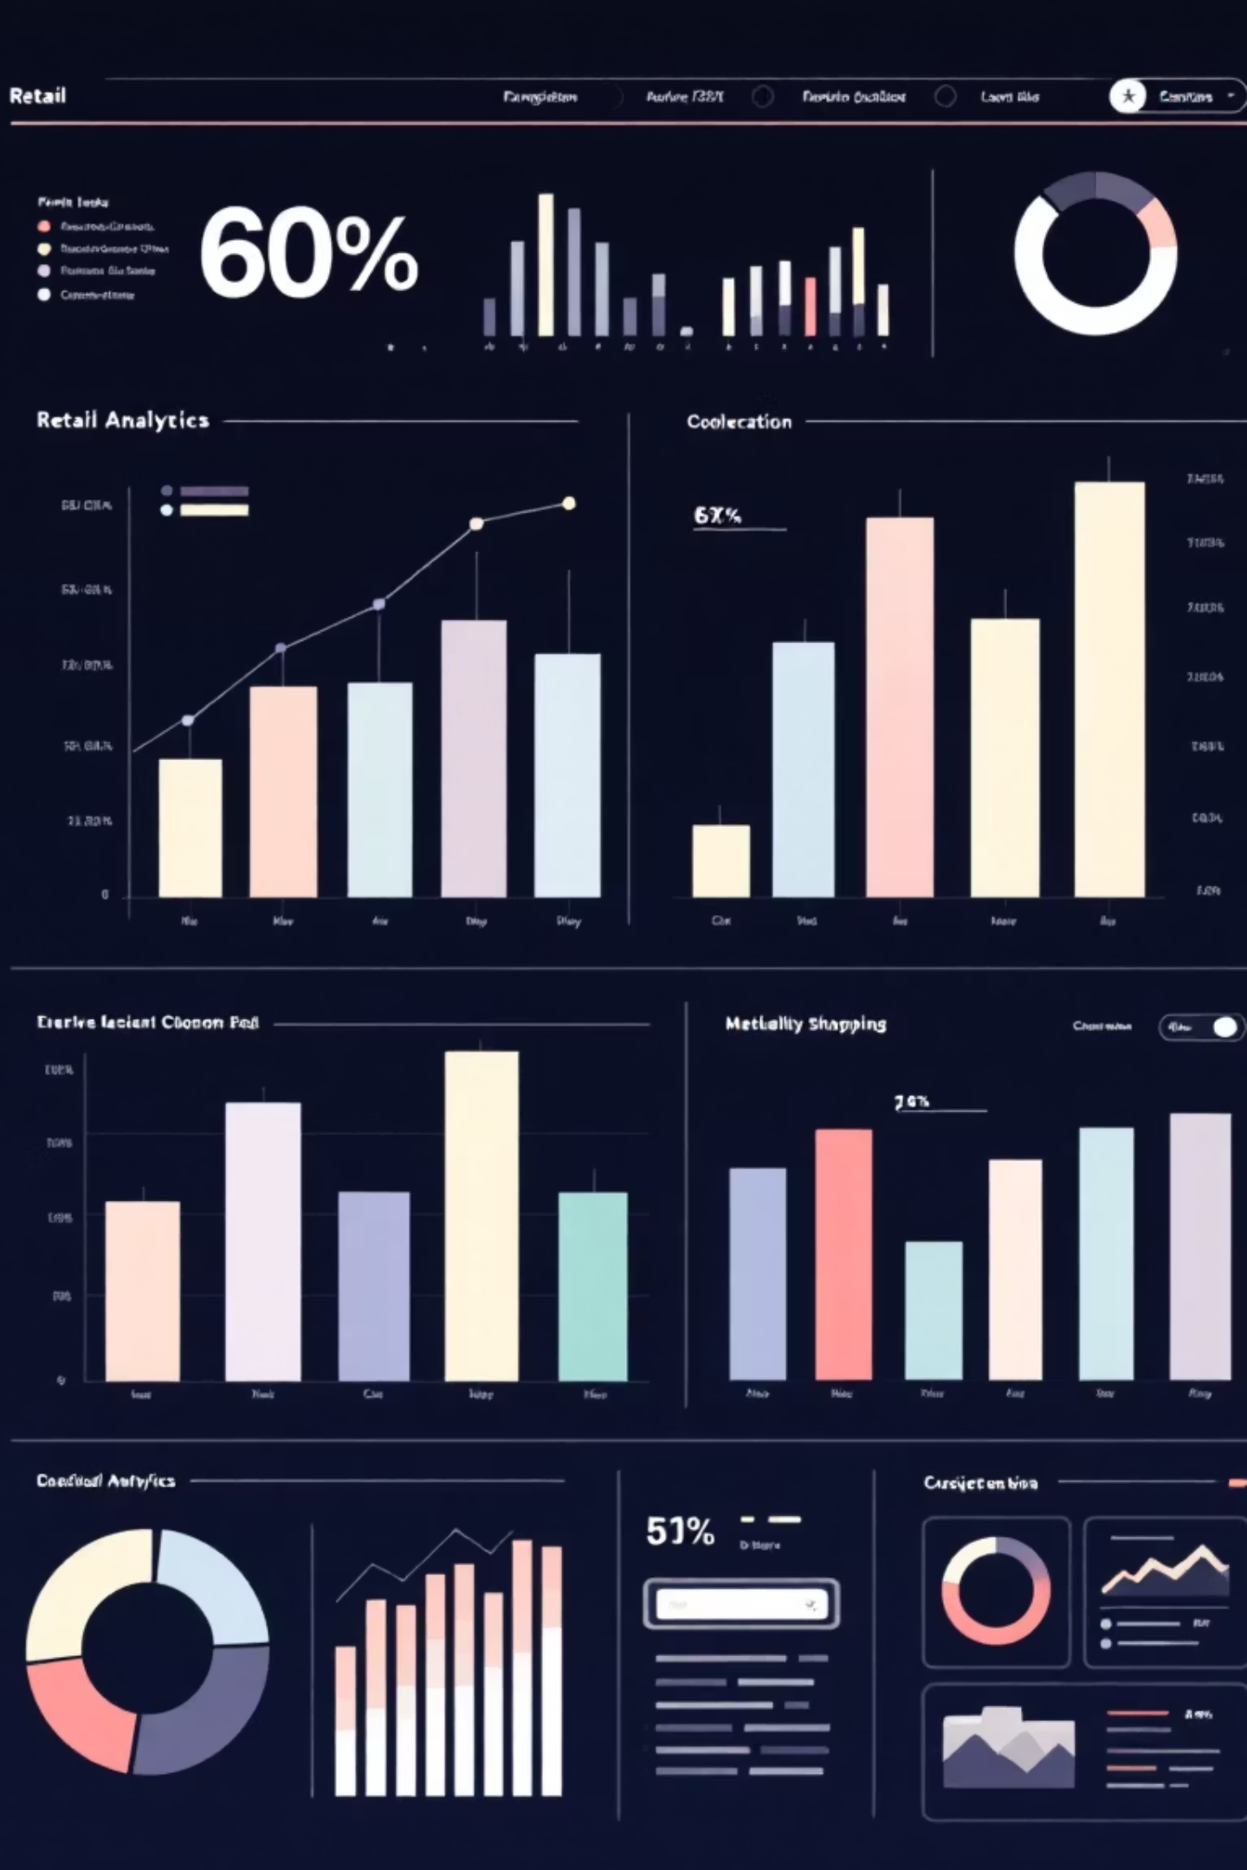
Customer Shopping Behavior Analysis
Uncovering insights from 3,900 purchases to guide strategic business decisions

Slide 2
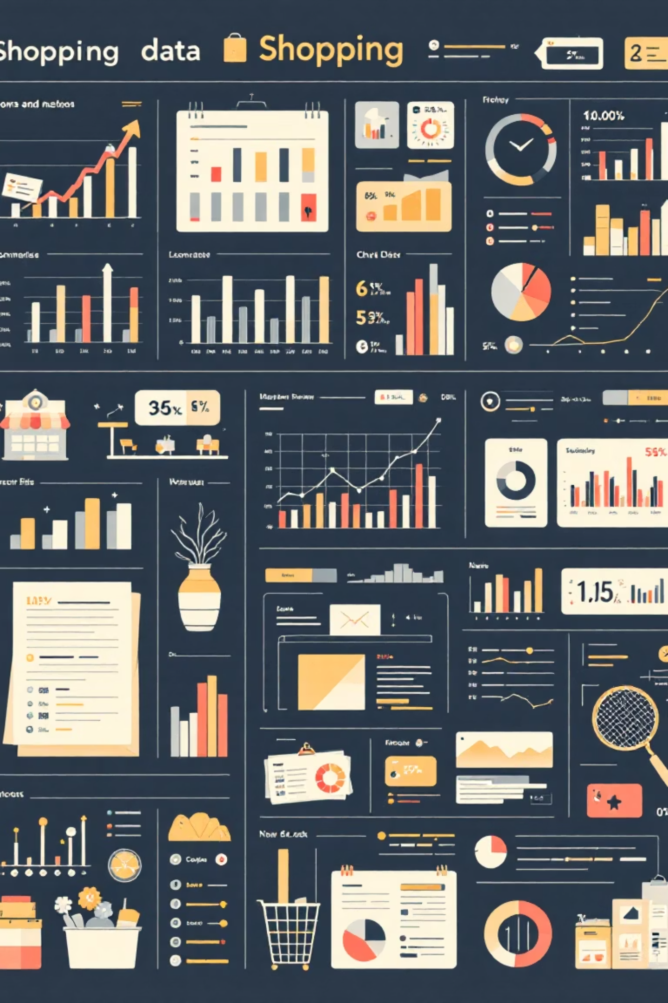
Dataset at a Glance
3,900
18
$59.76
Total Purchases
Data Points
Avg Purchase
Transactions analyzed across all categories
Features tracking demographics and behavior
Mean transaction value
3.75
Avg Rating
Customer satisfaction score

Slide 3

Data Preparation Journey
01
Data Loading & Exploration
Imported dataset, checked structure with pandas
02
Missing Data Handling
Imputed 37 missing review ratings using category medians
03
Feature Engineering
Created age groups and purchase frequency metrics
04
Database Integration
Connected to PostgreSQL for advanced analysis

Slide 4
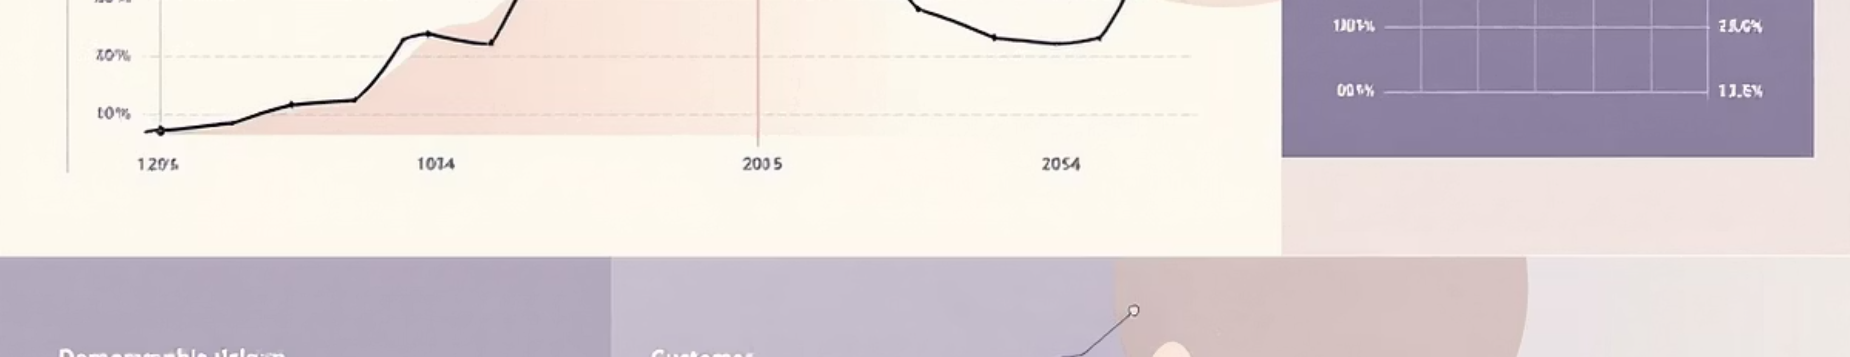
Revenue Insights
Gender Revenue Split
Age Group Performance
Male customers drive 68% of total revenue
Young Adults lead revenue generation
Male: $157,890
Young Adult: $62,143
Female: $75,191
Middle-aged: $59,197
Adult: $55,978

Slide 5


Product Performance Leaders
Gloves
Sandals
Highest rated: 3.86 stars
Second best: 3.84 stars
Boots
Strong performer: 3.82 stars
Top-rated products show consistent quality across categories

Slide 6
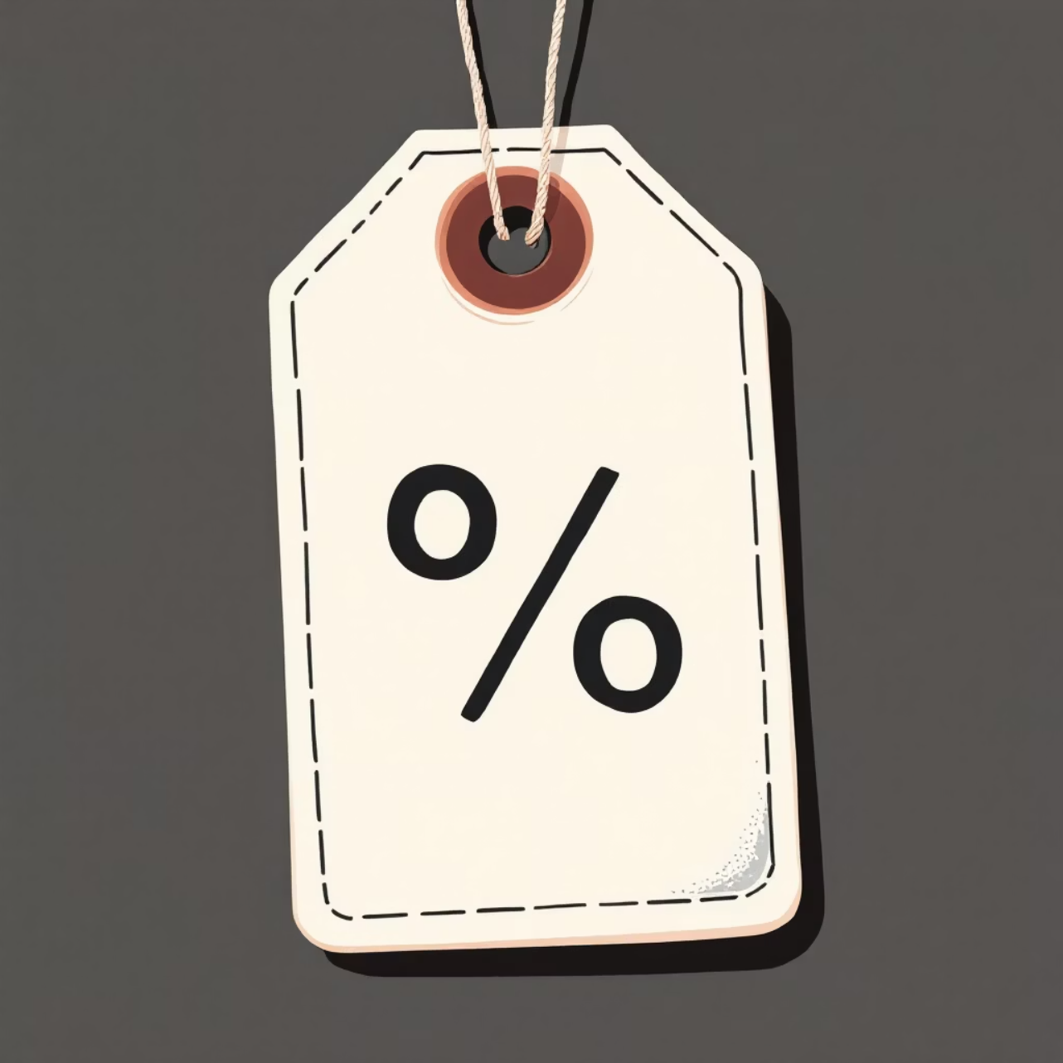
Discount Strategy Analysis
High-Value Discount Users
839 customers used discounts but spent above average
Discount-Dependent Products
Hat: 50% discount rate
Sneakers: 49.66%
Coat: 49.07%
Sweater: 48.17%
Pants: 47.37%

Slide 7



Customer Segmentation
New
1
83 customers
Returning
2
701 customers
Loyal
3
3,116 customers
80% of customer base classified as loyal - strong retention foundation

Slide 8
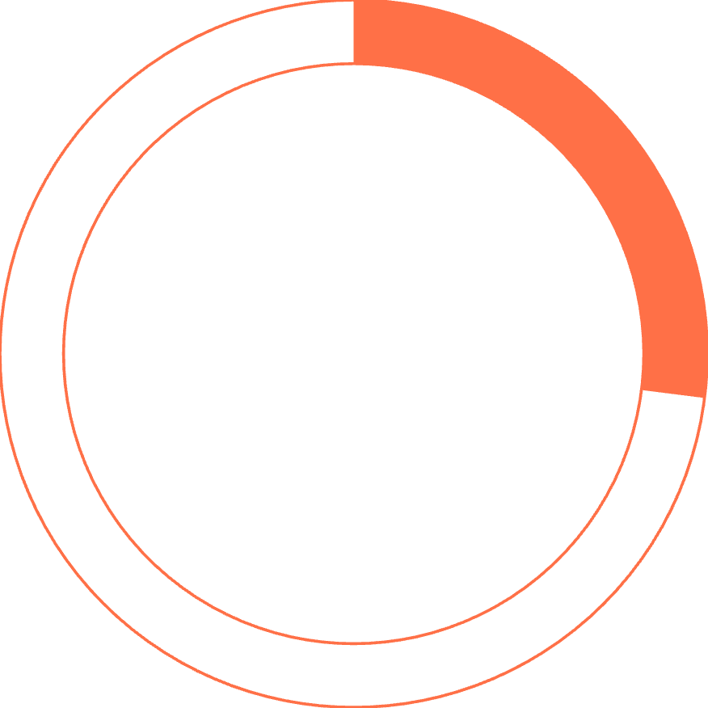

Subscription Status Reality Check
27%
73%
Subscribers
Non-Subscribers
1,053 customers with subscriptions
2,847 customers without subscriptions
Avg Spend: Subscribers $59.49 vs Non-subscribers $59.87
Repeat Buyers: 958 subscribers vs 2,518 non-subscribers with 5+ purchases

Slide 9
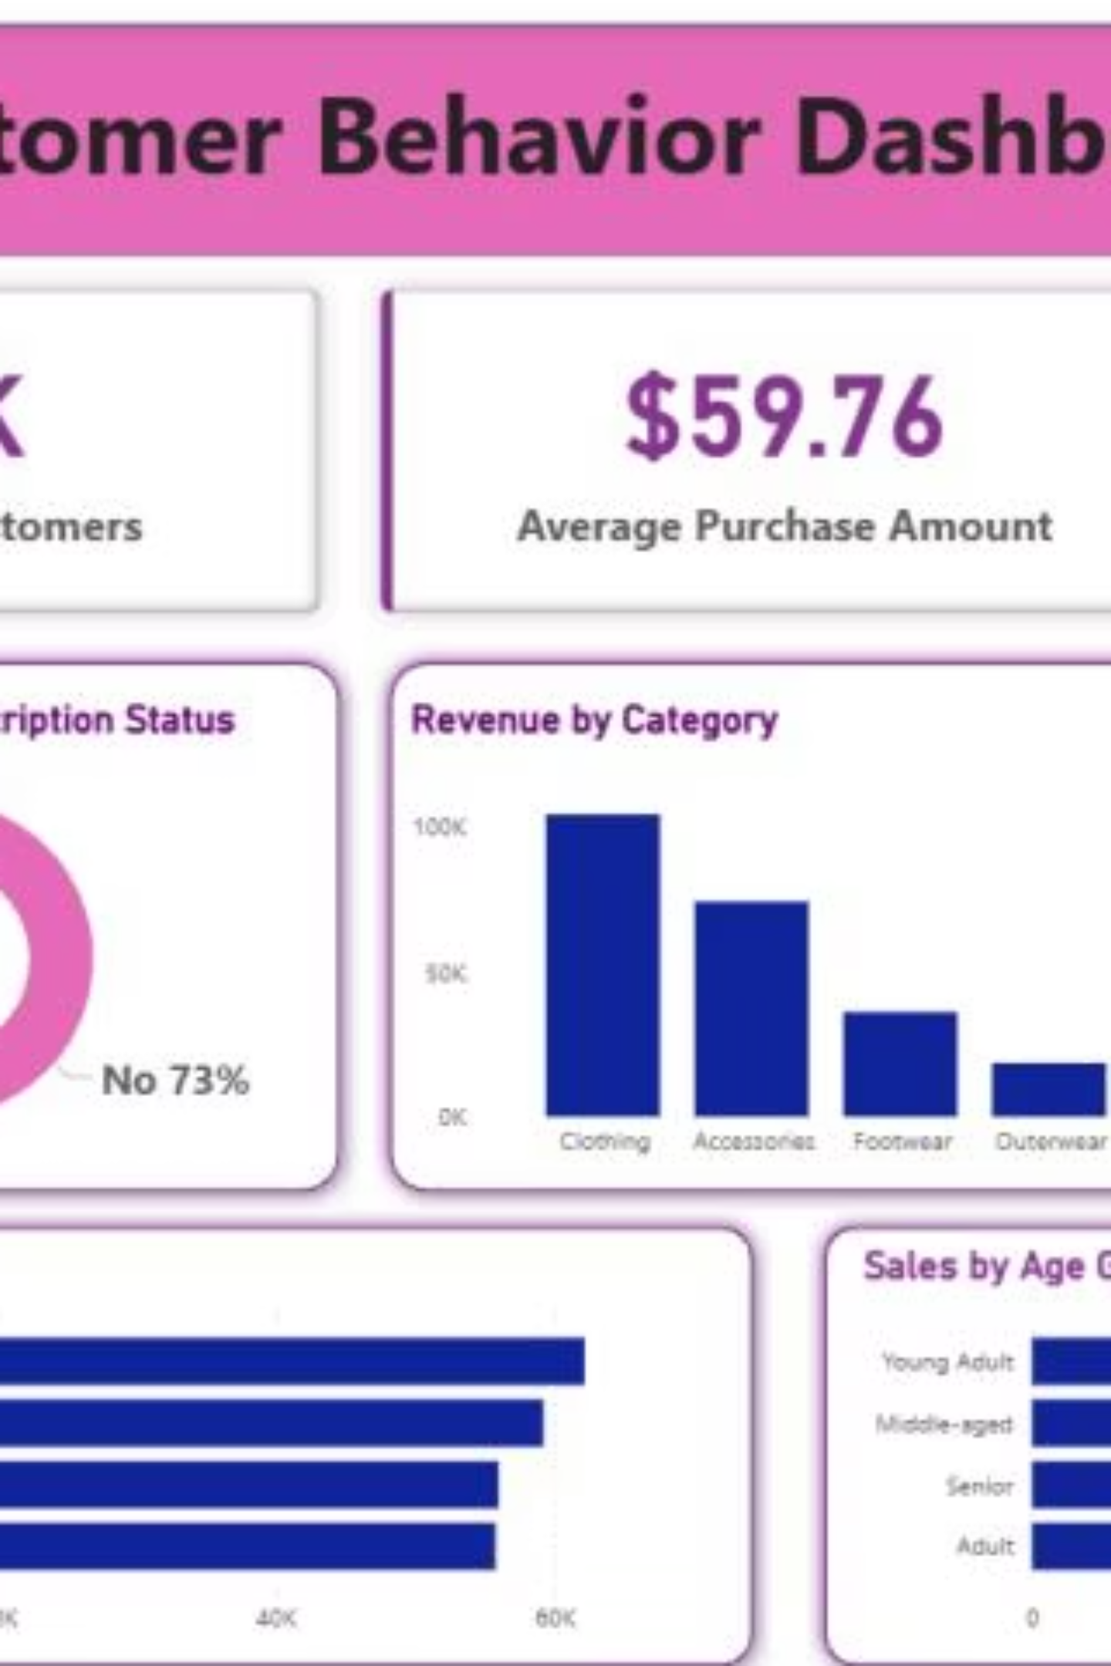
Interactive Dashboard
Power BI dashboard provides real-time insights into customer behavior, revenue trends, and product performance across all segments

Slide 10
Strategic Recommendations
Boost Subscriptions
Loyalty Programs
Review Discount Policy
Promote exclusive benefits - only 27% currently subscribed
Reward repeat buyers to strengthen the 80% loyal base
Balance sales boosts with margin control on high-discount items
Product Positioning
Targeted Marketing
Highlight top-rated products like Gloves and Sandals in campaigns
Focus on Young Adults and express-shipping users for maximum ROI

